Slide 1
What motivated British soldiers to continue fighting in the trenches?
L/O – To use evidence to build substantiated explanations for why British soldiers continued to fight in the trenches
Starter – What was the main reason why men signed up for the army? (Think about Propaganda posters)
Notes:
Answer should be – Patriotism. This lessons asks pupils to research the evidence to undermine this hypothesis

Slide 2
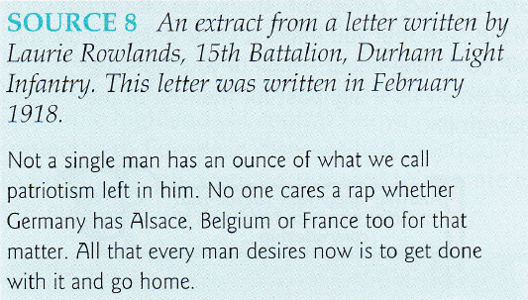
What motivated British soldiers to continue fighting in the trenches?
Notes:
Read source first, `

Slide 3
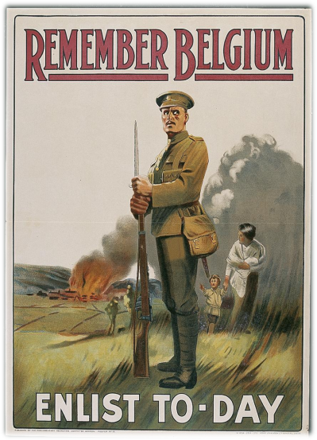
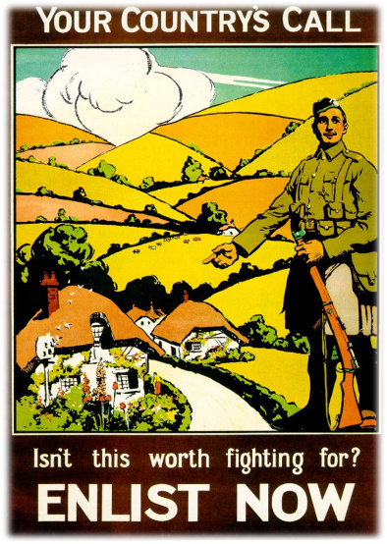
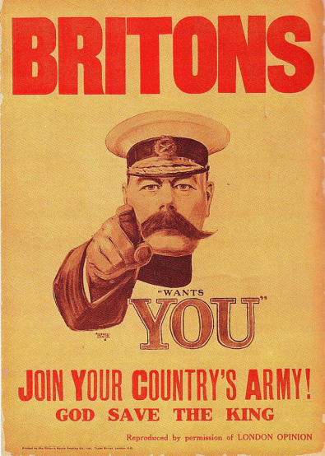
What motivated British soldiers to continue fighting in the trenches?
Clearly this is just one account of life in the trenches but many other sources also seem to indicate that, whilst patriotism may have motivated some soldiers to carry on fighting, it was not the main motivation for the majority of soldiers.
Your task is to find out what was.
Notes:
Read source first, `

Slide 4
Developing a hypothesis
EXPLANATION 1 – SOLDIERS WERE WELL CARED FOR
The army did as much as they could to keep morale high. A rotation system made sure that soldiers did not spend too long at the front line. Soldiers were well fed and that they received good medical care.
EXPLANATION 2 – TRENCH CONDITIONS WERE NOT AS BAD
As they have been presented in poems, films & novels. Trenches were carefully designed and kept as hygienic as possible.
EXPLANATION 3 – ARMY DISCIPLINE
Men continued to fight because they were afraid of being punished if they did not follow orders.
EXPLANATION 4 – COMRADESHIP
Men continued to fight because they did not want to let their friends down
Rank these explanations in order of importance in your book. Which was the main reason why British soldiers continued to fight?
EXPLANATION 5 – POPULAR COMMANDING OFFICERS
British soldiers were not let down by their commanding officers. The tactics and decisions taken by generals and commanding officers were not as bad as some accounts of the war make out.
EXPLANATION 6 – THE JOY OF WAR
Soldiers carried on fighting because they enjoyed it.
EXPLANATION 7 – DIFFERENT TIMES/DIFFERENT ATTITUDES
Soldiers were brought up to in a time where people were used to hardship
Notes:
Pupils to read each explanation and write them down in order of importance in their books. This is designed so pupils develop an initial hypothesis or main reason(s) why they think soldiers continued to fight in the trenches. The next research task will then help them explore each explanation in more detail.

Slide 5
Testing your hypothesis
In History, you cannot just state that one reason was more important than another. You need to give evidence to back-up or ‘substantiate’ your hypothesis.
Your next task is to actually look at the evidence and to see how it could be used to substantiate your hypothesis on why British soldiers continued to fight.
Read through your Evidence File and record any information that helps back-up (substantiate) each explanation on your A3 sheet.
Notes:
Pupils now look through their Evidence Packs (1 between 2) to find and record information, quotes and ideas that could be used to back-up and substantiate each explanation. E.g. as a class, get pupils to look at and read through Evidence File 1. Which explanation does this source help explain? What new information does this source give us? Then pupils can record information on their A3 sheets, model how to take notes on the whiteboard. THIS WILL TAKE you over a lesson to complete.

Slide 6
British Army Structure
Unit Structure | Number Units | Number of Men | Led by
Army Group | 5+ | 40,000 men | General
Corps. | 2+ | 20,000 men | Lieutenant General
Division | 2+ | 10-12,000 men | Major General
Brigades | 3+ | 3-4000 men | Brigadier General
Battalions | 4+ | 800-1000 men | Lieutenant Colonel
Companies | 4+ | 160-200 men | Captain
Platoons | 4+ | 40-50 men | Lieutenant
Squads | 4+ | 10-14 men | Lance Corporal

Slide 7
Developing a new hypothesis
Having looked at and recorded the evidence, you can see that some explanations seem more persuasive (better) than others.
Now look over the 7 explanations again and rank them in your books in order of importance.
What is the best explanation why British soldiers continued to fight?
What is the worst explanation why British soldiers continued to fight?
What is your hypothesis? – What motivated British soldiers to continue fighting in the trenches?

Slide 8
Drafting the Essay
Introduction
Explanation 1 – i.e. The Joy of War
Having worked out your own hypothesis, you now need to write an essay answering the question: ‘What motivated British soldiers to continue fighting in the trenches?’
Your answer should start with an introduction
The main body should contain 7 paragraphs – one for each of the explanations you have researched
You should finish with an overall conclusion – what was the main factor that motivated soldiers to continue fighting?
  Remember – not all causes are equally important!
Explanation 2
Explanation 3
Explanation 4
Explanation 5
Explanation 6
Explanation 7
Conclusion
Notes:
Good idea to give pupils another lesson to plan in class so you can go round and help. Get them to type up for homework.

Slide 9
Example Introduction
When we think of conditions for soldiers in World War One, history teaches us that the soldiers had to endure terrible conditions. Muddy trenches, rats, disease, poor food and the constant threat of death all combined to make fighting in the war a horrendous experience. If this was so, why didn’t more men run away? What kept them fighting?
In this essay, I will be exploring that question in order to find out what motivated British soldiers to continue fighting. I will argue that …., … and …. were the main factors that motivated soldiers but I will also be explaining why other factors contributed. The first factor I will examine is…..

Slide 10
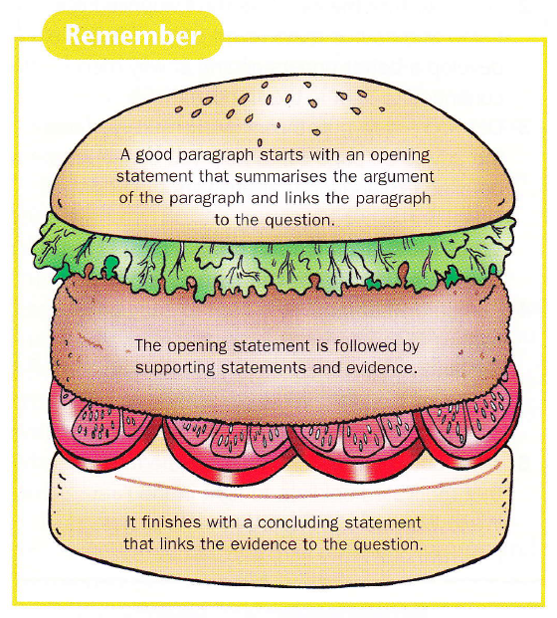
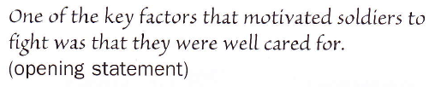
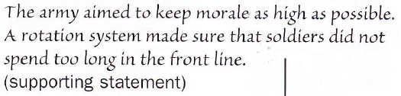
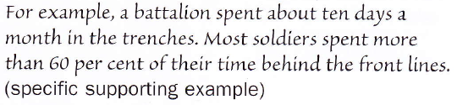
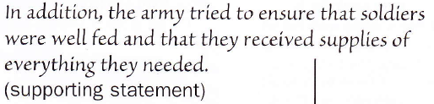
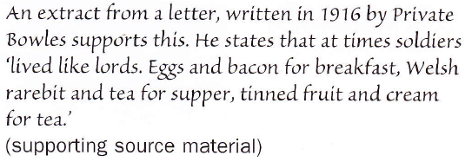
Building substantiated explanations
In Years 7 and 8 you may have used a Hamburger Paragraph to help you explain why things happen in history:
What do we need to finish this paragraph and how could we write it?

Slide 11

Linking Reasons and Concluding
In your conclusion, you need to think and argue about what the most important reason(s) are.
Try to consider how the reasons are linked when writing your conclusion. See the next slide for good linking words.
A good way to consider whether something is important is to think counter-factually – would soldiers still have been motivated if that reason wasn’t there?

Slide 12
Contribute | Allow | Latent | Trigger | Incite
Exacerbate | Spark | Significantly | Nevertheless | Despite
Further | Foundation | Birth | Beginning | Element
Compelled | Subsequently | Encourage | Develop | Nurtured
Preceding | Consequently | Impede | The root of… | However
The led to | In addition | Prevent | Deter | Erupt
Bring about | Fundamentally | Underpin | Discourage | Support
Origins | This bred… | Foundation | Principally | Permit

Slide 13
Plenary
Compare what motivated men to carry on fighting in the trenches with what motivated men in other conflicts you have studied or know about. What similarities and differences can you find?
What about today? Do you think the factors that motivated soldiers to fight in the First World War are still important factors that motivate people to fight in conflicts today?
Did we meet our learning objective?
L/O – To use evidence to build substantiated explanations for why British soldiers continued to fight in the trenches

